Slide 1
Machine Learning for Security Analysts
Out of the Buzzword and into the Mainstream

Slide 2
$ whoami
I hate these pages
Name: GTKlondike
(Independent security researcher)
(Consulting is my day job)
Passionate about network security
(Attack and Defense)
NetSec Explained: A passion project and YouTube channel which covers intermediate and advanced level network security topics in an easy to understand way.

Slide 3
What Is Machine Learning?
What is it we’re trying to do?

Slide 4
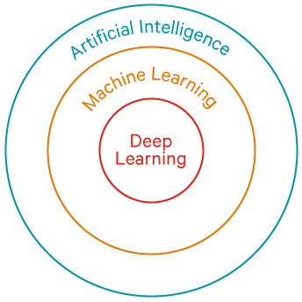
What Is Machine Learning?
AI, ML, and deep learning

Slide 5
What Is Machine Learning?
What is it we’re trying to do?
Machine Learning is a set of statistical techniques, that enables a process of information mining, pattern discovery, and drawing inferences from data.
Machine Learning uses algorithms to “learn” from past data to predict future outcomes.

Slide 6
Why This Talk?
In the future, we are all Skynet
Today, 25% of security products for detection have some form of machine learning
To properly deploy and manage machine learning products, you will need to understand how they operate to ensure they are working efficiently.
Source: Gartner Core Security; 2016

Slide 7
Machine Learning Examples
Predicting house prices
 | LotArea | MoSold | YrSold | SaleCondition | SalePrice
0 | 8450 | 2 | 2008 | Normal | 208500
1 | 9600 | 5 | 2007 | Normal | 181500
2 | 11250 | 9 | 2008 | Normal | 223500
3 | 9550 | 2 | 2006 | Abnorml | 140000
4 | 14260 | 12 | 2008 | Normal | 250000

Slide 8
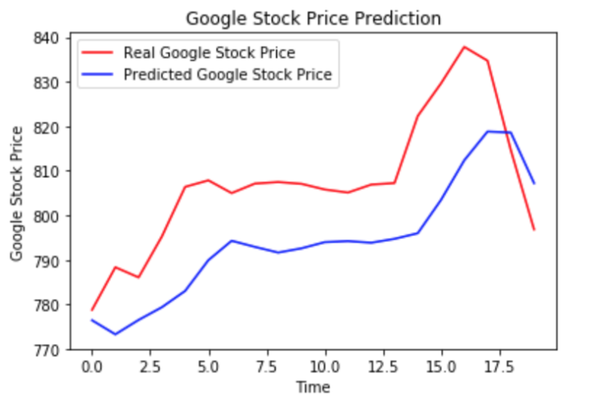
Machine Learning Examples
Predicting stock trends

Slide 9
7 Step Machine Learning Process
Build, train, test
Gather the Data
Prepare the Data
Choose a Model
Train the Model
Evaluate the Model
Hyperparameter Tuning
Prediction

Slide 10
Machine Learning, Head First
Building it from scratch
We’re going to start by building a Spam Filter
(Something we’re all familiar with)
Input: Emails
Output: Determine if this is Spam or not

Slide 11
Machine Learning, Head First
But first, a little background
Text | Category
“A great game” | Sports
“The election was over” | Not sports
“Very clean match” | Sports
“A clean but forgettable game” | Sports
“It was a close election” | Not sports
Source: Applying Multinomial Naïve Bayes

Slide 12
Machine Learning, Head First
Bayes’ Theorem
P(A|B) = P(B|A) x P(A) P(B)
P(Sports|”a very close game”) =
P(“a very close game”|Sports) x P(Sports)
P(“a very close game”)
Source: Applying Multinomial Naïve Bayes

Slide 13
Machine Learning, Head First
Bayes’ Theorem
P(“a very close game”) =
P(a) x P(very) x P(close) x P(game)
P(“a very close game” | Not Sports) =
P(a | Not Sports) x P(very | Not Sports) x P(close | Not Sports) x P(game | Not Sports)
Source: Applying Multinomial Naïve Bayes

Slide 14
Machine Learning, Head First
Another look at the table
Text | Category
“A great game” | Sports
“The election was over” | Not sports
“Very clean match” | Sports
“A clean but forgettable game” | Sports
“It was a close election” | Not sports
Source: Applying Multinomial Naïve Bayes

Slide 15
Machine Learning, Head First
But wait, what if this happens?
P(“a very close game” | Sports) =
P(a | Sports) x P(very | Sports) x P(close | Sports) x P(game | Sports)
P(“a very close game” | Sports) =
(2/11) x (1/11) x (0/11) x (2/11) = 0
Source: Applying Multinomial Naïve Bayes

Slide 16
Machine Learning, Head First
But wait, what if this happens?
P(“a very close game” | Sports) =
(2/11) x (1/11) x (0/11) x (2/11) = 0
P(Sports|”a very close game”) =
0 x P(Sports)
P(“a very close game”) = 0
Source: Applying Multinomial Naïve Bayes

Slide 17
Machine Learning, Head First
Multinomial Naive Bayes
P(A|B) = (Θ₁ x .. x Θ_{d}) = (i=1, .., d) | Σ | x_{i} + α N + αd
Source: Applying Multinomial Naïve Bayes

Slide 18
Machine Learning, Head First
Calculate the probabilities
Word | P(word | Sports) | P(word | Not sports)
A | 2 + 1 11 + 14 | 1 + 1 9 + 14
Very | 1 + 1 11 + 14 | 0 + 1 9 + 14
Close | 0 + 1 11 + 14 | 1 + 1 9 + 14
Game | 2 + 1 11 + 14 | 0 + 1 9 + 14
Source: Applying Multinomial Naïve Bayes

Slide 19
Machine Learning, Head First
Let’s finish it up
P(“a very close game” | Sports) =
P(a | Sports) x P(very | Sports) x P(close | ports) x P(game | Sports) = 0.0000461
P(“a very close game” | Not sports) =
P(a | Not sports) x P(very | Not sports) x P(close | Not sports) x P(game | Not sports) = 0.0000143
Source: Applying Multinomial Naïve Bayes

Slide 20
Machine Learning, Head First
What we need to keep track of
The total number of unique words
The number of unique words in Spam
The number of unique words in Ham
The count of each word in Spam
The count of each word in Ham

Slide 21
Machine Learning, Head First
Let’s look at one of the emails
Re: Re: East Asian fonts in Lenny. Thanks for your support. Installing unifonts did it well for me. ;)
Nima
--
To UNSUBSCRIBE, email to debian-user-REQUEST@lists.debian.org
with a subject of "unsubscribe". Trouble? Contact listmaster@lists.debian.org

Slide 22
Machine Learning, Head First
Remove punctuation and stopwords
Re: Re: East Asian fonts in Lenny. Thanks for your support. Installing unifonts did it well for me. ;)
Nima
--
To UNSUBSCRIBE, email to debian-user-REQUEST@lists.debian.org
with a subject of "unsubscribe". Trouble? Contact listmaster@lists.debian.org

Slide 23
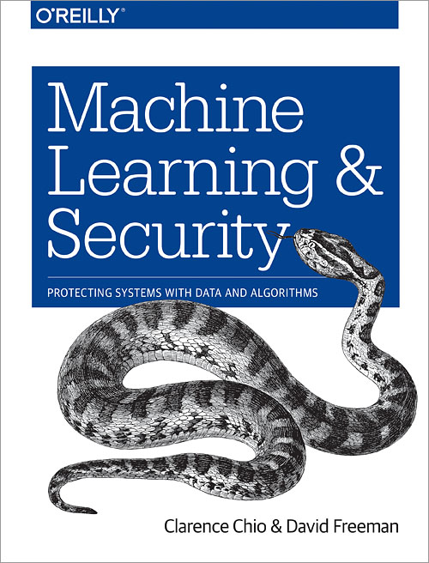
References
And further reading
Gartner Core Security
The Fast-Evolving State of Security Analytics; April 2016
Applying Multinomial Naïve Bayes
Applying Multinomial Naive Bayes to NLP Problems: A Practical Explanation; July 2017
AI Village
https://aivillage.org/
Machine Learning and Security
By Clarence Chio & David Freeman

Slide 24
Thank You!
Email: GTKlondike@gmail.com
YouTube: Netsec Explained
Website: https://netsecexplained.com/

